Slide 1
Predictability of
Consciousness States Studied with Human Brain Magnetism
Noboru Tanizuka ^{*1} Mostafizur R. Khan^{*1,3} Teruhisa Hochin^{*2}
^{*1} Graduate School of Science, Osaka Prefecture University, Osaka
^{*2} Graduate School of Sci. and Techn., Kyoto Inst. of Technology, Kyoto
*3 (at present ) Summit System Service, Inc., Osaka
5th Int. Conf. on Unsolved Problems on Noise and Fluctuations in Physics, Biology and High Technology École Normale Supérieure de Lyon, Lyon, 2008.6.2-6

Slide 2
motive for study
complex and active dynamics of the electric current in the neural networks of the cerebral cortex seems to reflect the state of consciousness (a kind of data processing in the brain)
the activity of the neural current can be measured with magnetoencephalogram (MEG) at a high spatiotemporal resolving power
is a consciousness state able to be given in a quantitative way by the analysis of the spatiotemporal data of neural current activity?
ex. a state of mind identified through a quantitative agent?
at a first stage, we started to do experiments under simple consciousness states and do the analysis of the measurement data.

Slide 3
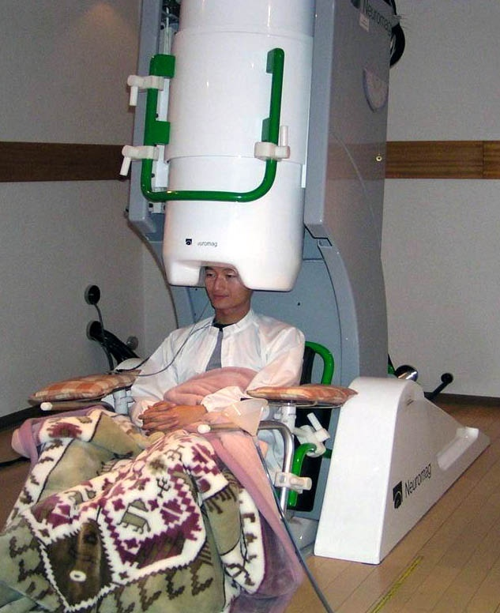
MEG (magnetoencephalogram)
AIST, Osaka
122 channels
61 positions over scalp
Resolving power
space: 5mm, time: 1ms measurement: fT noise level: 2fT
(Geomagn.: 30μT)
Magnetic shield room: 1/10⁵ - 1/10⁴
Neuromag-122TM, 4-D Neuroimaging Ltd, Finland Planer-differential type coil
Notes:
産業技術総合研究所 人間福祉医工学研究部門 関西センター
MEGの利点 時間分解能 EEG と異なる点 空間局所的神経電流の性質を投影 ベクトルが得られる。 ネットワークの情報に有利

Slide 4
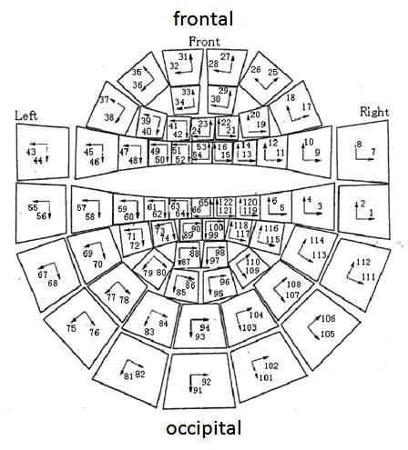
measurement channels

Slide 5
mental states and associated rhythms considered as events of the brain
rhythms | δ | θ | α | β | γ
frequency Hz mental state | 0.5-4 1.5-4.0 sleep | 4-8 4-7 mental arithmetic | 8-13 8-16 eyes closed at rest | 13-35 18-30 eyes opened at mental activity | 35-100 36-64 perception, a circuit of cortex and brain stem
Notes:
頭が働くのは、目的がある。入力に対して情報を処理している。皮質の電流に構造があるはず。意味的な構造か形式的な構造かいずれか。時系列として測定。最も簡単な解析はね周波数スペクトル。仕事によりスペクトル構造が変わるはず。波の大きさは?

Slide 6
estimate a dynamical system of the intensity variations of brain magnetism and its rhythms
measurement data
difficult to estimate because of unknown system from which data was measured
possible to estimate because we have the RBF network system into which the information of data is taken as the synaptic coefficients

Slide 7
at first, a simple system was tested
frequency spectrum of the magnetism variations measured at an occipital channel at under eyes closed at rest of a healthy young male
s.r. 2.5 ms, 4000 points
alpha rhythm
subject: yi. 22, ecr-103ch

Slide 8
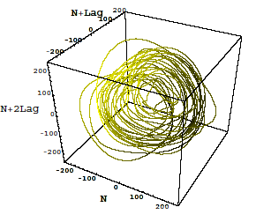
the alpha rhythm embedded in a state space
2.5ms 2.5sec m=3 τ=15ms

Slide 9
correlation dimension of alpha rhythm
system’s dynamical dimension is necessary for the RBF network analysis
GP, Judd
2.5msec 1-1000point, ch81

Slide 10
Radial Basis Function Network
C1
C1
C1
x1
C1
x1
x1
x1
λ1
λ1
λ1
x2
λ1
x₂
x₃
x_{N+1}
x2
x2
x2
C2
C2
C2
C2
∑
∑
∑
λ2
∑
λ2
λ2
λ2
…
…
…
…
…
…
…
…
…
…
λN
λN
λN
λN
xN
xN
xN
xN
CN
CN
CN
CN

Slide 11
solve the network function from real data

Slide 12
map function estimated from data
alpha rhythm: 2～3 wave lengths and 20～30 wave lengths
a short term
for solution
x1= (1, 7, 13, 19) → x2 = (20)
x100=(100, 106, 112,118) → x101 = (119)
sampling rate: 2.5ms
cj = xj , j=1,…,100
prediction
initial value x101= (101, 107, 113, 119) ←real data
free run x101=(120), x102, ……. 200 steps by the solution function
{120,121,....,319} at the parameter b = 1000,..,b = 10000,..

Slide 13
evaluate from the function for short term
measured
predicted
b=10000
xt+2τ=35 fT xt+3τ=135 fT
short term used for the solution of the function
reproduction
prediction

Slide 14
correlation coefficient real and the predicted
a short term
10000
7000
4000
b=1000

Slide 15
22,103ch
a long term
for solution
x1= (1, 2, 3, 4) → x2 = (5)
x100=(100, 101, 102,103) → x101 = (104)
cj = xj , j=1,…,100
sampling rate: 25ms
initial vectors x1, x51, x76, x101
reproduction, prediction
evaluate from the estimated function
free run
EX. initial vector x76:

Slide 16
real data
free run
correlation coefficient
reproduction
prediction

Slide 17
Henon map

Slide 18
alpha rhythm
real data
time

Slide 19
the map function of the Henon solved by RFB network
k=1
k=50
k=80
k=100

Slide 20
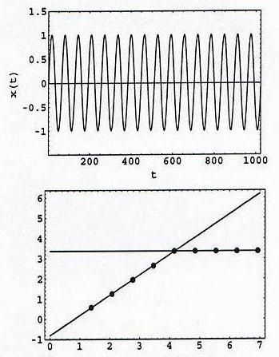
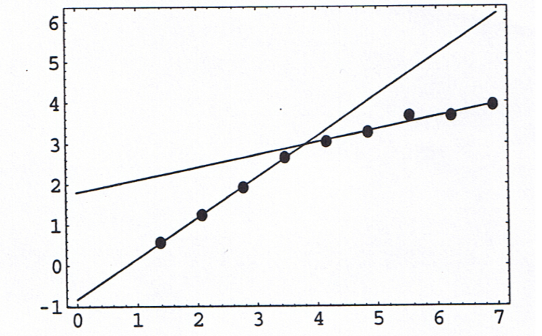
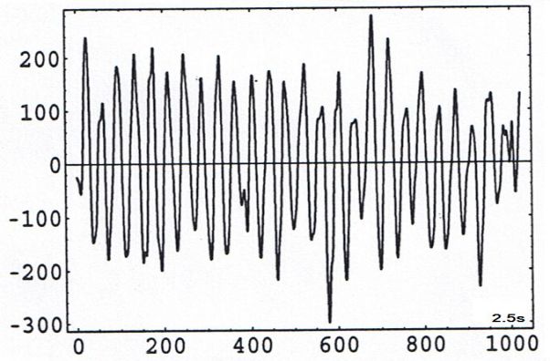
alpha rhythm
data window
the map function for every data window k, stepped by 50ms
The function of the alpha rhythm fluctuates along passage of time.
short term and long term prediction of alpha rhythm
1.0
0.31
1.0
0
250ms
100ms
2.5s
Hurst exponent, sine, by D kimoto
Hurst exponent, alpha rhythm,
YI-ecr 103ch, 2.5s, by D kimoto

Slide 21
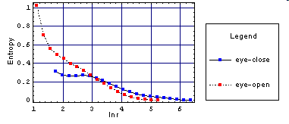
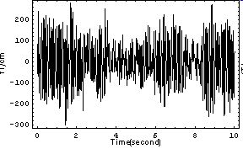
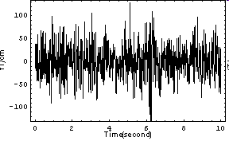
comparison of the rhythms appearing at different mental states of subject yi
KS-entropy
103
closed
opened
103ch, 0-2.5s
2500
2000
1500
eyes closed
1000
eyes opened
500
0
10
20
30
40
50
eyes closed 0-10sec
eyes opened 0-10sec

Slide 22
frequency spectrum of another subject mm, 22 healthy male
eyes closed at rest
eyes opened at mental arithmetic
eyes opened at rest
frontal
30ch
occipital
94ch
Notes:
意識状態によって周波数スペクトルが変わる。

Slide 23
magnetic vectors at 61 positions over scalp under different consciousness states
Vectors at time
eyes crosed at rest
eyes opened at mental arithmetic
eyes opened at rest
frontal
frontal
frontal
occipital
occipital
occipital
Subject mm 22, healthy male

Slide 24
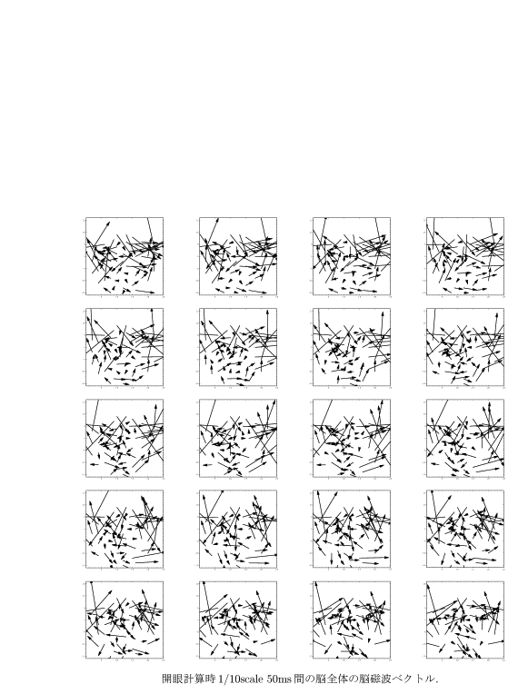
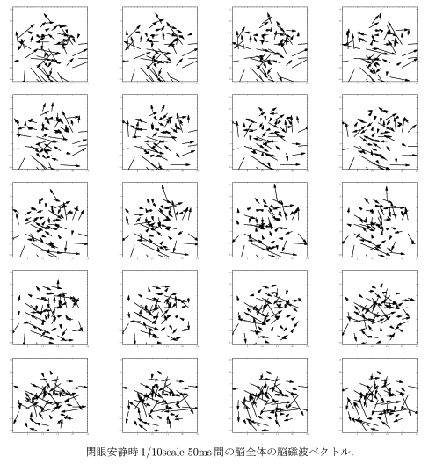
different dynamical patterns of the magnetic vectors under different consciousness states
The vectors varying along time passage
eyes closed at rest
eyes opened at mental arithmetic

Slide 25
difference vectors at 61 positions
difference vectors :
t2 - t1=2.5ms
ecr
eoma
eor
frontal
occipital

Slide 26
conclusion
alpha rhythm as a most remarkable activity in a resting state: possible to predict for the short term, impossible for the long term
a network (function) generating the alpha rhythm is fluctuating with the passage of time
the pattern of the magnetic vectors is evidently different for the different consciousness state

